Slide 1
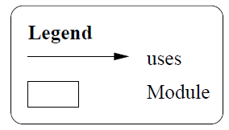
Overall Use Structure
BBD-V (Mobile Devices)
BBD-Ops (Central Managing Service)
BBD-M (Journey Information)

Slide 2
BBD-V Use Structure
Send vehicle speed/location
JSON Encoder/decoder
WKWYL GPS API
Send on-line driver registration
Send on-line vehicle registration
Encode vehicle location/speed
Encode on-line driver registration
Encode on-line vehicle registration

Slide 3
Send Unauthorised access report
BBD-Ops Use Structure
Authorisation logic
Process Journey report
Receive journey report request
Decode vehicle location/speed
Encode Unauthorised access report
Decode journey report request
Unauthorised report access repository
Send journey report
Process Vehicle Location/Speed
Driver Behaviour
Monitor
Police IT RESTful API
Journey Report Repository
Vehicle Location/speed repository
Encode Journey report
Real-time tracking logic
Decode on-line driver registration
Process on-line driver registration
Process on-line vehicle registration
Decode on-line vehicle registration
On-line driver registration repository
On-line vehicle registration repository

Slide 4
BBD-M Use Structure
Send journey report request
Display journey report
Encode journey report request
Receive journey report
Decode journey report received

Slide 5
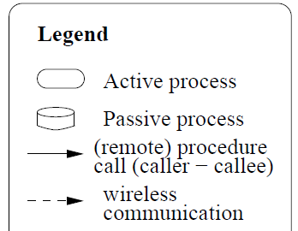
Overall Process Structure
BBD-V (Mobile Devices)
Gathering Journey Information
Registration Requests
N
1
BBD-Ops (Central Managing Service)
Monitoring drivers
Reporting to police
Real-time tracking
Persisting information
Generating reports
Authorising report accesses
1
BBD-M (Journey Information)
Report requests
Display reports
N

Slide 6
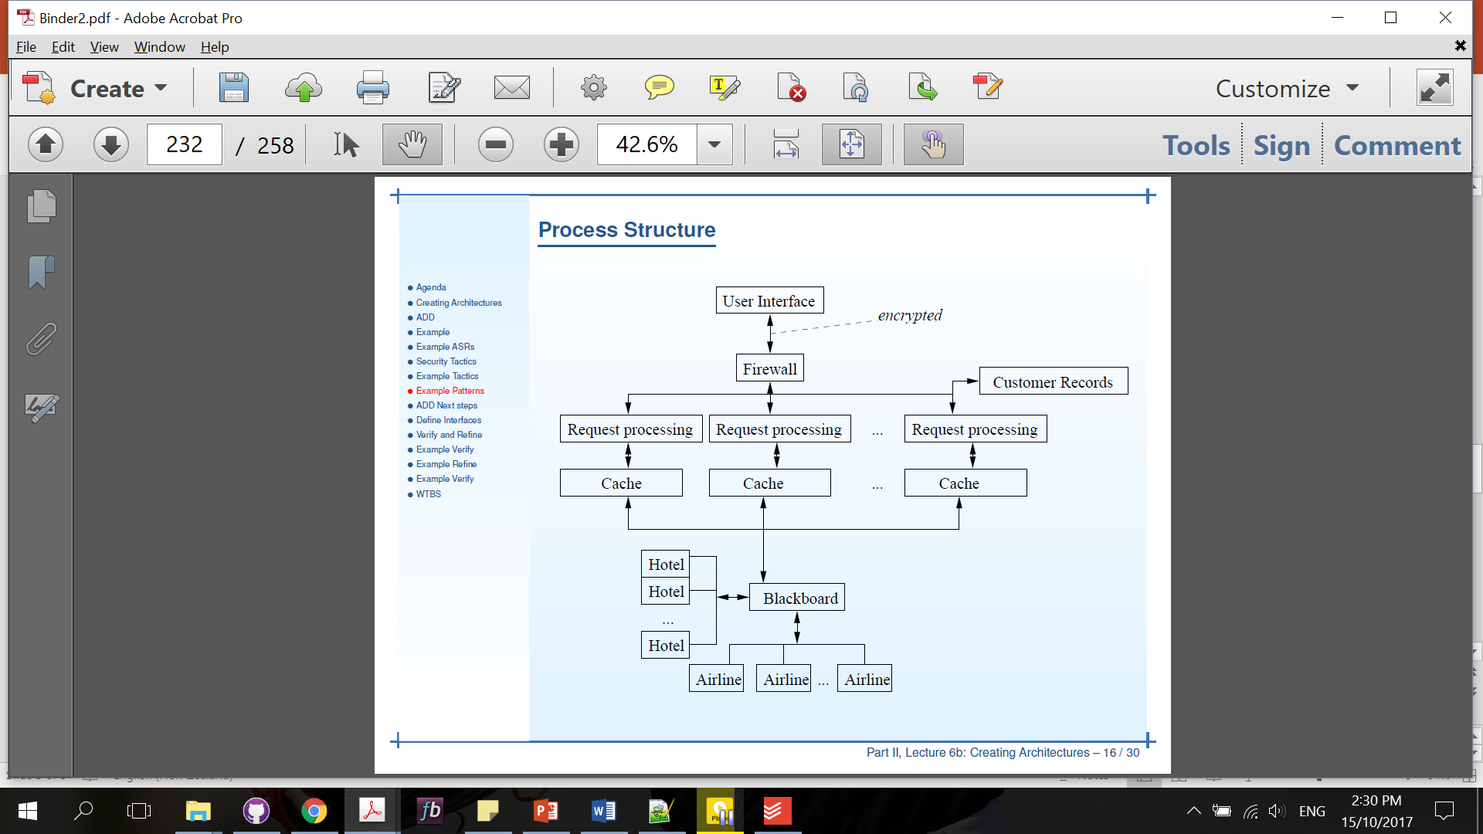
“Process” Structure
UI
1
N
N
N
BBD-V
sending on-line driver registration
sending on-line vehicle registration
Gathering and processing vehicle speed/location
Driver information Cache
Vehicle information Cache
Journey information Cache
Broker (BBD-Ops)
1

Slide 7
“Process” Structure
Broker Interface
1
BBD-Ops
N
on-line driver registration processing
on-line vehicle registration processing
vehicle speed/location processing
Monitor Drivers
Processing report
Authorising report requests
1
1
1
Persist on-line vehicle registration
Persist vehicle speed/location
1
1
Persist on-line driver registration
Reporting to Police process
Persist journey report
Persist unauthorised report requests
Realtime tracking process
Generate unauthorised access report

Slide 8
“Process” Structure
BBD-M
UI
Generating and sending report requests
Processing and displaying reports received
Report requests cache
Journey report received Cache
1
1
Broker (BBD-Ops)

Slide 9
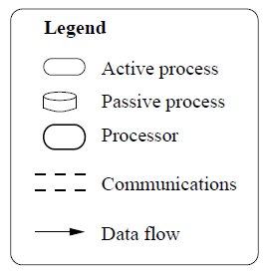
Deployment
Wireless Network
Local Area Network
Overall
BBD-V (Mobile Devices)
Gathering Journey Information
Registration Requests
Send Vehicle location/speed
BBD-Ops (Central Managing Service)
Monitoring drivers
Reporting to police
Real-time tracking
Persisting information
Generating reports
Authorising report accesses
Database Servers
BBD-M (Journey Information)
Report requests
Display reports

Slide 10
Deployment
Wireless Network
BBD-V
Send Vehicle location/speed
Send Vehicle registration
Send driver registration

Slide 11
Deployment
Wireless Network
Local Area Network
on-line vehicle registration processing
BBD-Ops
on-line driver registration processing
vehicle speed/location processing
Authorising report requests
Processing report
Driver Monitor
1
1
1
Persist on-line vehicle registration
Persist vehicle speed/location
1
1
Persist on-line driver registration
Reporting to Police process
Persist journey report
Persist unauthorised report requests
Realtime tracking process
Generate unauthorised access report

Slide 12
Deployment
Wireless Network
Local Area Network
BBD-M
Send Vehicle location/speed

Slide 13
WKWYL GPS API
Send on-line driver registration
Send on-line vehicle registration
“Process” Structure
BBD-Ops
Noot used
Encode on-line driver registration
Encode on-line vehicle registration
Send vehicle speed/location
Process Vehicle Location/Speed
Vehicle Location/speed repository
Driver Information
Driver Behaviour Monitor

Slide 14
Layered structure
Presentation
Application
Database
BBD-OpS
BBD-OpS
BBD-OpS

Slide 15
“Process” Structure
BBD-M

Slide 16
Send vehicle Location/speed
Process on-line registration
Encode/decode vehicle location/speed
Process vehicle location/speed
Estimator
Send on-line registration
Vehicle location/speed repository
Process vehicle Location/speed
Real time tracking
GPS module
Broker
WKWYL API
Journey Information Repository
Reporting to Police
Reporting to NZTA
Driver Information
Operations
History
Process report
Generate report
Operations

